Slide 1

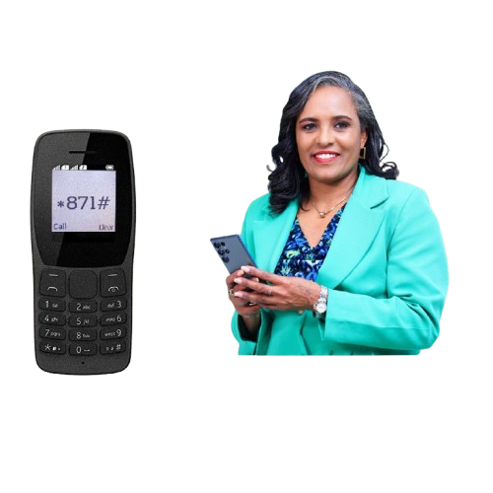

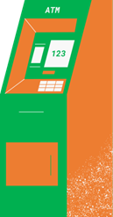
Payment and System Admin
Service
Up-time
Transaction
USSD
Mobile App
Mobile Banking
406K
3B ETB
ATM
Siinqee Digital
ATM and POS
61K
78M ETB
Reason
-Internet banking is having an issue on OHS (The OHS server is Down)

Slide 2





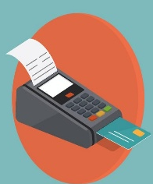
ATM and POS Deployment Status and Efficiency
Image Indexing
1
254
2
99.6%
3
0.4%
No of ATM
Started
Operation
253
1 ATM
Pending
Online
Close
Offline
Efficiency
238
5
10
94%
1
250
2
100%
250
No of POS
Started
Operation

Slide 3
List of ATM with out of cash
 | District | Branch | Terminal | Out of cash(hr)
 | NORTH | wossen | A78ATM01 | 48
 | WEST FINFINE | Burayu ATm 01 | A07ATM01 | 24
 | Hawasa | Adola Wayu | R14ATM01 | 48
 | Jimma | Agaro | P01ATM01 | 48
 | Dire Dawa | Haromaya | K05ATM01 | 24
 | East Finfine | Gelan | A16ATM01 | 36
 | South | Bekanisa | A44ATM01 | 36
 | Odaa | Odaa | Odaa 01 | 48

